Slide 1
Water crisis? What water crisis? Water supply options for a growing Melbourne after the Millennium Drought
Christopher J Walsh
Waterway Ecosystem Research Group,
School of Ecosystem and Forest Sciences
The University of Melbourne
http://urbanstreams.net

Slide 2
Outline
The Millennium Drought: the problems of relying on river flows for our water supply
Melbourne’s water supply: 2006 – a fateful turning point
What could have been and what might be: a more sustainable approach to urban water supply

Slide 3
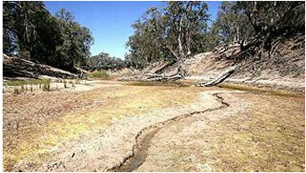
The Millennium Drought (2001–2009)
“Worst drought on record for SE Australia”
2001–2006: 18% less rain over the Murray Darling Basin
Gross regional Product dropped by 16%
Flows in the lower Murray dropped by…
82%
milduramillenniumdrought.weebly.com
Natural flows into the river dropped by 45%
We kept extracting water at much the same rate as normal…
Dijk et al. (2013) Water Resources Research 49

Slide 4
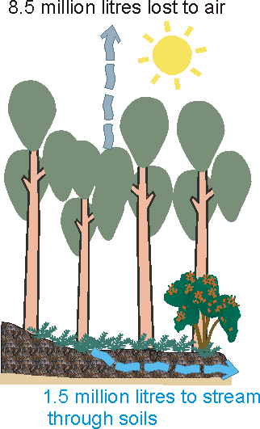
Why does 18% less rainfall
result in 45% less river flows?
Most rainfall ends up back in the air
Much is stored in the soil and
Transpired by vegetation back to the
atmosphere.
The longer it is dry, the more capacity
soils have to hold back water for
uptake by vegetation
Years of soil water deficit increase the
probability of forest fires

Slide 5
Melbourne’s water supply and wastewater disposal and treatment system
Dams with capacity for ~10 y demand in a severe drought (with no augmentation)
WWTPs with excellent treatment and little env impact

Slide 6
Water flowing into Melbourne’s reservoirs 1912–2006 (GL/y)
2006: a very dry year after 10 quite dry years….
Long-term average
Average 1997-2006
Volume (GL/y)
Year
Source: Government of Victoria Sustainable Water Supply: Central Region (2006)

Slide 7
Water flowing into Melbourne’s reservoirs 1912–2006 (GL/y)
2006: a very dry year after 10 quite dry years….
An unprecedented decade of demand mainly exceeding inflows
Long-term average
Average 1997-2006
Volume (GL/y)
Demand
Year

Slide 8
Water flowing into Melbourne’s reservoirs 1912–2006 (GL/y)
2006: a very dry year after 10 quite dry years….
An unprecedented decade of demand mainly exceeding inflows
Worst-case climate-change and demand predictions pointed to
demand exceeding long-term supply by 2020-2030
A short-term augmentation of 50-100 GL/y was needed
Volume (GL/y)
Projected inflows with climate change
1990s behaviour
2000s behaviour
Demand
Year
Sources: Melbourne Water (2006) Water Supply Demand Strategy
Jones and Durak (20005) CSIRO

Slide 9
Water flowing into Melbourne’s reservoirs 1912–2006 (GL/y)
Feasibility studies commissioned for potential augmentation
100 GL of recycled wastewater from ETP to Cardinia
Extraction from Yarra River at Collingwood
Desalination plant
Economic winner of
the three.
Politically unpalatable
Not economically
viable
Most expensive,
Most energy intensive
But perceived as most
certain (climate independent)
Volume (GL/y)
Projected inflows with climated change
1990s behaviour
2000s behaviour
Demand
Year

Slide 10
Recycled wastewater: the 2006 augmentation proposal
A pipeline from Eastern Treatment Plant to Cardinia:
Cheap because an upgrade to near-potable effluent was already planned and budgeted for.
Energy requirement per kL ~ 30% that required for desal
Politically unpalatable…influence of the Toowoomba referendum?

Slide 11
The Wonthaggi desalination plant: the successful proposal
Extract seawater from Bass Strait at Wonthaggi
Extract the salt (return concentrated brine to the sea),
pump desalinated water to Cardinia (a service reservoir)

Slide 12
The Wonthaggi desalination plant: the successful proposal
The dominant water industry advice in 2006 was to develop a ‘portfolio’ of different water sources that included a 50 GL/y desalination plant.
But desal was attractive to the politicians because it was sold as ‘climate independent’
A 150 GL/y plant was ordered.
A new energy-intensive industry when climate change mitigation requires reduction of energy consumption
And the cost of the water that it provides?...

Slide 13
The Wonthaggi desalination plant: the successful proposal
The retail cost of our water supply system is ~$2.50–$3.00 /kL
The cost of desalinated water was (and continues to be*) claimed as $2–$3 /kL.
But let’s do the maths:
Plant became operational - December 2012
First order of water placed by government –
for 50 GL in Summer 2016-17 (4.2 years later)
Victoria pay Aquasure $620 m/y to operate the plant + ~$200 m for the first order of 50 GL.
= 620 m x 4.2 + 200 m = $2,800 m for 50 GL (or 50 m kL)
= $56 /kL
*Gray (2016) The Conversation.
https://theconversation.com/melbournes-desalination-plant-is-just-one-part-of-drought-proofing-water-supply-55934

Slide 14
Why did we get a 150 GL plant when we only needed a 50 GL one?
Volume (GL/y)
Projected inflows with climated change
1990s behaviour
2000s behaviour
In selecting size of plant
a “step change” in runoff
was assumed over best
scientific climate predictions
Demand
Year

Slide 15
The curious turn for water policy in 2006
Technical advice to invest in a portfolio of different augmentation options ignored
A single technology perceived as safe selected, over a cheaper, more sustainable, but less politically palatable alternative
The chosen plant was 2-3 times larger than necessary to meet short-term augmentation needs (reducing incentive to invest in more sustainable augmentation options)
The sizing decision was based on a scenario that was much worse than the worst-case climate change predictions of the time (that remain largely the same today)
In this policy space, climate change predictions were perceived as too optimistic: resulting in immediate, radical action.

Slide 16
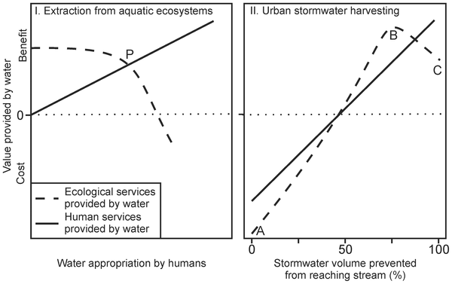
Trading off water that humans use and water that aquatic ecosystems need
So, to protect our rivers, won’t desal (or wastewater recycling) help to reduce our risk of running our rivers dry?
Gleick & Palaniappan M (2010) Proc Natl Acad Sci U S A 107

Slide 17
Trading off water that humans use and water that aquatic ecosystems need
No…
Volumes supplied by desal are a tiny fraction of agricultural demands.
In our cities and towns, desal prevents us from solving a more pressing problem, and a seizing a remarkable opportunity…
Gleick & Palaniappan M (2010) Proc Natl Acad Sci U S A 107

Slide 18
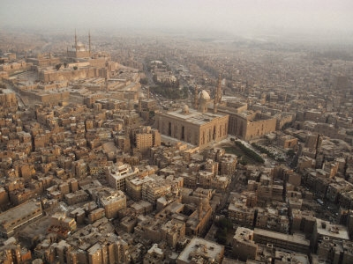
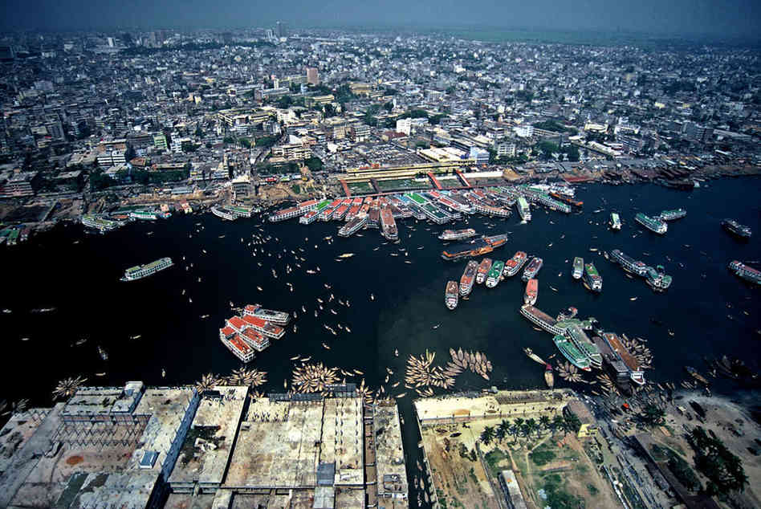
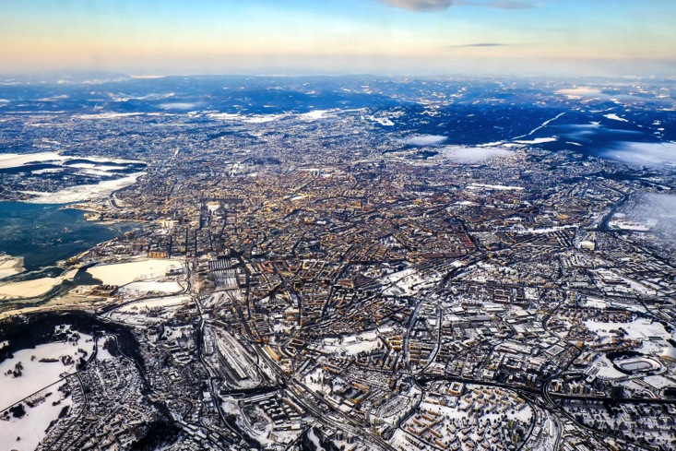
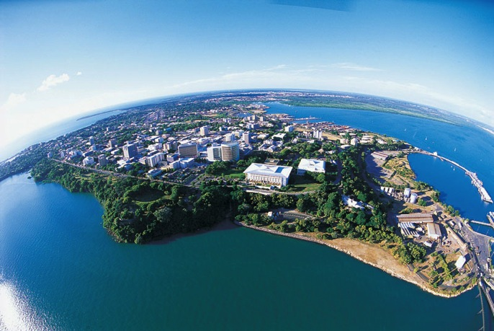
The challenges of managing urban water
Cairo
Dhaka
http://media.npr.org
http://worldlitstories.wikispaces.com
Oslo
Darwin
http://www.taevapiltnik.ee/blog/
Source: Tourism NT

Slide 19
Primary urban water challenges no matter where you are…
Provision of clean water
Treatment and disposal of wastewater
Prevention of flooding
(And usually last priority, protection of the city’s streams, rivers, and downstream lakes/bays/ocean)

Slide 20
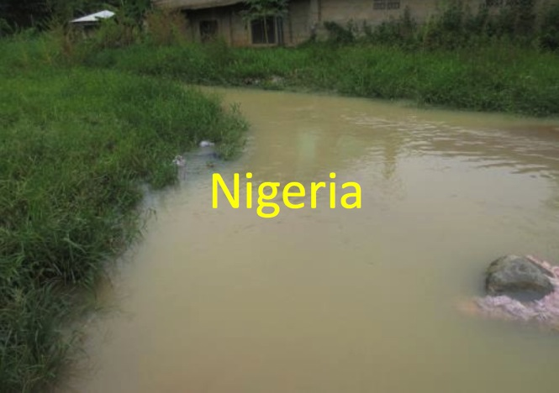
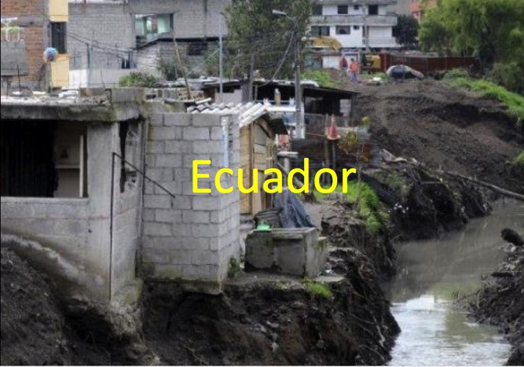
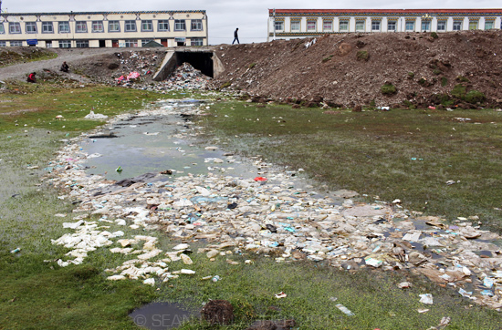
Source: Mandu Essien-Ibok
Source: Bianca Ríos-Touma
What happens in cities where wastewater and flooding are
well managed?
China
http://gallagher-photo.com

Slide 21
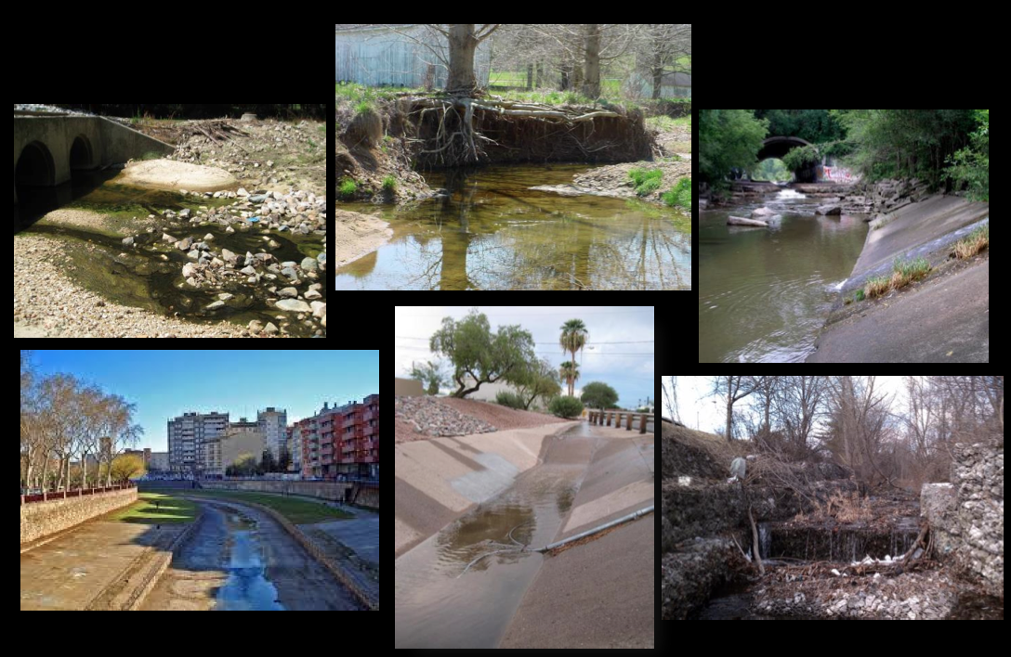
Streams of modern cities with good water supply, sanitation, flood management

Slide 22
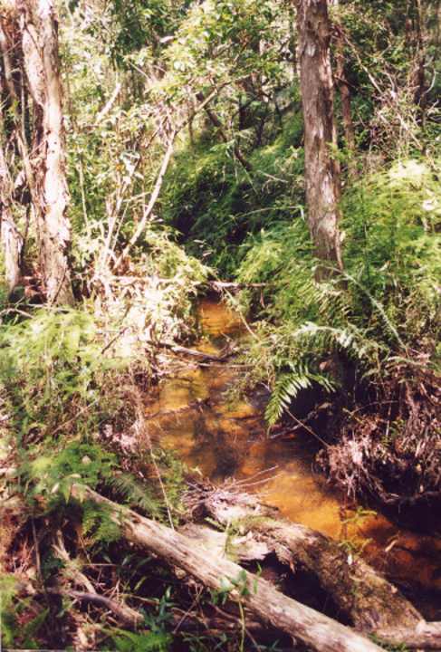
Why should we care about streams of our cities?
McRae Ck, Yarra Ranges
…And what if protecting our cities’ streams can help deliver our other basic needs of water supply and flood protection?

Slide 23
Streams of modern cities with good water supply, sanitation, flood management

Slide 24
Streams of modern cities with good water supply, sanitation, flood management
Urban stormwater runoff:
our standard approaches to managing it (for flood protection) degrade our cities’ streams and rivers.*
Alternative approaches could protect and restore them
(and more effectively protect us from floods and provide us with a huge, sustainable water supply…)
*Walsh et al. 2005 J N Am Benthol Soc 24: 706

Slide 25
Water on a hectare of forest over a year...

Slide 26
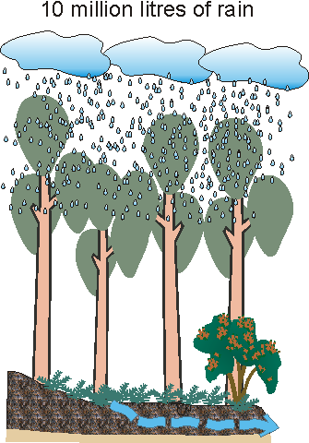
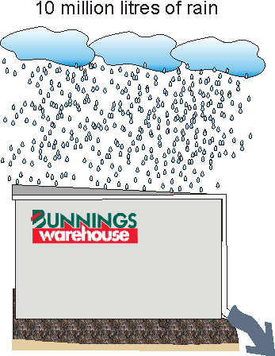
Replace the forest with a building...

Slide 27
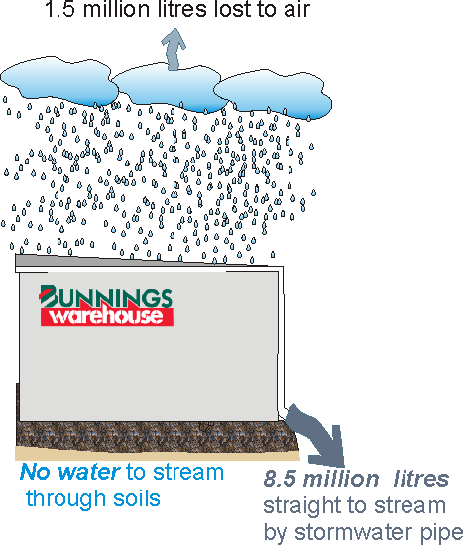
Stormwater runoff is a BIG flow problem

Slide 28
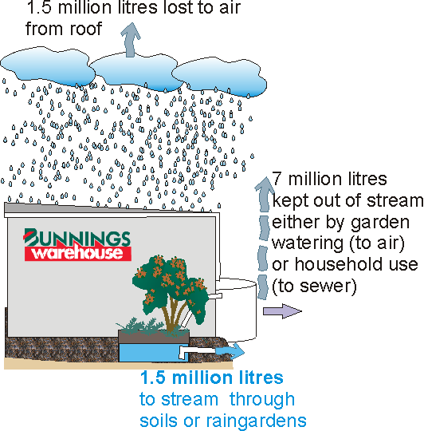
Keeping stormwater in the catchment...
or (over)-irrigation
TF
Notes:
Contrary to popular belief. The best thing we can do for our urban streams is to keep most of the stormwater out of them altogether (so that we can more effectively restore a clean and healthy baseflow).

Slide 29
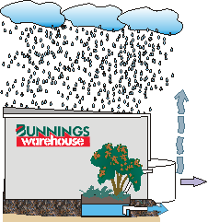
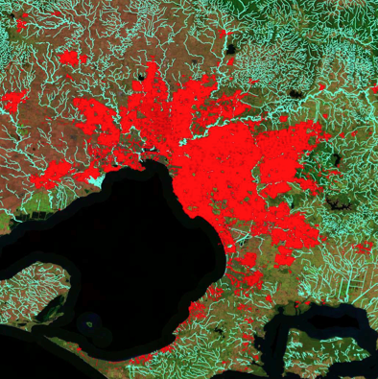
Volume reduction and infiltration restoration increasingly difficult at larger scales
400 – 605 GL/y down our drains
Lost dry-weather flows
to restore through infiltration:
50 - 145 GL/y
(very dry yr – avg yr)
Excess runoff to keep out of
waterways by harvesting or
evapo-transpiration losses:
350 - 463 GL/y
(very dry yr – avg yr)
http://urbanstreams.net/tools/melbrunoff/
Notes:
Using our maps of impervious, we are able to estimate how much Melbourne’s stormwater system reduces baseflows in our creeks (~80 GL/y across the region), and how much excess problem stormwater flows into the creeks every time it rains (rather than going back into the air like it did when Melbourne was covered by forests): 350 GL/y in a dry year (like the last 4), to 500 GL/y in an average year (like 2010 is shaping to be), to much more in a wet year!

Slide 30
Do we really need a ‘climate-independent’ source of water?
Volume of stormwater runoff is much less variable than river runoff.
It has been consistently near Melbourne’s total demand to date
Accounting for urban growth and climate change, future excess stormwater runoff will track demand.
It is a large, reliable, largely unused augmentation source: not using it perpetuates environmental damage
Volume (GL/y)
Demand
Excess stormwater
Year
http://urbanstreams.net/tools/melbrunoff/

Slide 31
Water scarcity? Our rivers experience it before we do
Walsh et al. (2012) PLoS ONE 7(9): e45814

Slide 32
Urban stormwater runoff: a remarkable opportunity:
Benefits to us of using it match benefits to the environment.
So, why aren’t we doing it?
Walsh et al. (2012) PLoS ONE 7(9): e45814

Slide 33
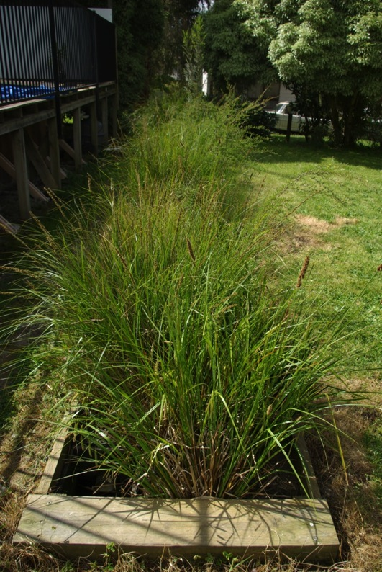
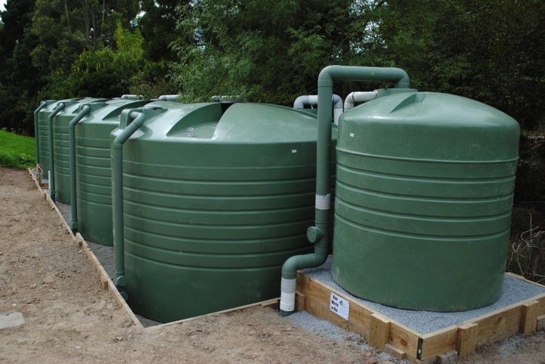
Urban stormwater management for flow regime protection requires…
Infiltration systems that restore lost baseflows (of good quality)
and
harvesting systems to keep excess water from streams (indoor use to replace/augment potable water supply or irrigation of open space to replace lost evapotranspiration losses)

Slide 34

Is it possible?
The Little Stringybark Creek project is showing it is...
urbanstreams.net/lsc
~300 Stormwater control measures installed (230 private properties + public land)
31 ML/y harvested (>75% of the demand of treated properties)
38 ML/y infiltrated (restoration of baseflows and evapotranspiration)
First signs of ecological improvement in the creek
First push by MW to require stormwater harvesting to potable in Sunbury…

